Slide 1
Project Hand-offs: A Guide
Andy Boughton
Center for Statistical Genetics
April 22, 2022

Slide 2

University Research: An overview
Students build software
They write a paper that makes a bunch of promises
Students graduate
People use software and have questions
Flail and run around
Key personnel (students) depart at a predictable rate, and take knowledge with them. What does this mean for community resources?
Our theme song: https://www.youtube.com/watch?v=EVZh4WcdC3s

Slide 3
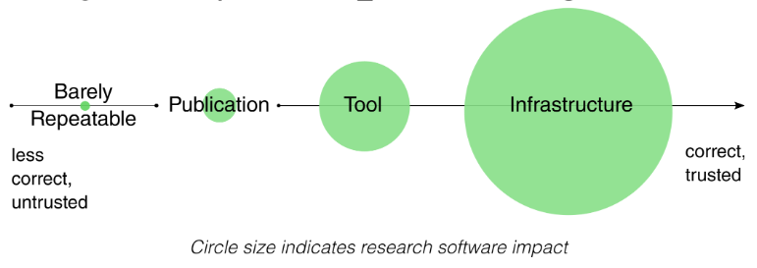
Harrison, S., Dasgupta, A., Waldman, S., Henderson, A. & Lovell, C. How reproducible should research software be? https://zenodo.org/record/4761866 (2021)
NASA Technology Readiness Levels: https://en.wikipedia.org/wiki/Technology_readiness_level

Slide 4
Levels of Preservation: What are your goals?
Living service
More work
Maintenance mode
More risk (if needed later)
Archival
https://www.software.ac.uk/resources/approaches-software-sustainability

Slide 5

Archiving software
Baseline preservation for any project

Slide 6
A focus on what and how
An archival project is not expected to receive new features or support; “at your own risk”
Interested parties may have to rewrite the software to carry it forward
Focus on scientific reproducibility: if an error is found, allow future readers to know what happened and why
BUT: If you promise that your tool can be used by others, then there are additional requirements...

Slide 7

Help people to use your archive
Contains exact code, not just a prose description of methods
Clean up dead code, broken methods, or “test” files
Tag releases if your program changes over time
Good archives start with good development habits. Don’t wait until the end!
Taschuk, M. & Wilson, G. Ten simple rules for making research software more robust. PLoS Comput Biol 13, e1005412 (2017). https://journals.plos.org/ploscompbiol/article?id=10.1371/journal.pcbi.1005412

Slide 8
“...more than 2000 replication datasets... execute[d] ... in a clean runtime environment... 74% of R files failed to complete without error in the initial execution, while 56% failed when code cleaning was applied...
...our automated study has a comparable success rate to the reported manual reproducibility....”
“...mandated data archiving policies that require the inclusion of a data availability statement in the manuscript improve the odds of finding the data online almost 1000-fold compared to having no policy... rates at journals with less stringent policies were only very slightly higher than those with no policy at all.”
https://www.nature.com/articles/s41597-022-01143-6
https://faseb.onlinelibrary.wiley.com/doi/full/10.1096/fj.12-218164
Notes:
The most impactful “auto fixes” included:
badly/ under-specified dependencies
system-dependent file paths
This just assessed whether they ran, not whether it got same results as the paper! Other reproducibility studies tackle the latter problem. Even once you get the code running, the picture for reproducibility is still quite bleak.

Slide 9










Capture the environment
Much of the behavior of code is driven by external factors
Avoid hard-coded paths like “/User/broken_for_you/Documents”
Specify exact required dependencies using a dependency manager
Data matters!
Include a small test dataset to run the program
Provide example configuration or parameter files with critical options
Consider containers (Docker, Singularity, etc) to distribute dependencies along with the program
Be able to follow your own setup instructions on a new computer
cget

Slide 10
Automation tells you what is true*
As you develop, automate your routine validation steps via test frameworks + continuous integration (eg pytest + GitHub actions)
Instead of a markdown file specifying commands that are out of date, use bash scripts or workflow tools (makefile / snakemake)
For REST APIs, use an API framework that auto-generates documentation (eg OpenAPI format). (for CLIs, use argparse)
Instructions maintained by hand quickly become lies
Example GitHub actions file for Python tests: https://github.com/abought/zorp/blob/develop/.github/workflows/pythonpackage.yml
Standard CLI tooling that auto-generates documentation: https://docs.python.org/3/library/argparse.html

Slide 11

Tell a story
Use example commands to provide an obvious starting point
Add value and remove distractions
Clean up dead code or unused files
Add example data (and file format docs)
Use source code comments to explain tricky bits
Add citations for unusual methods, or to explain how parameters were chosen
https://jupyter.org
https://rmarkdown.rstudio.com
https://en.wikipedia.org/wiki/Literate_programming
https://stackoverflow.blog/2021/12/23/best-practices-for-writing-code-comments/
https://selftaughtcoders.com/how-to-quickly-and-effectively-read-other-peoples-code/

Slide 12
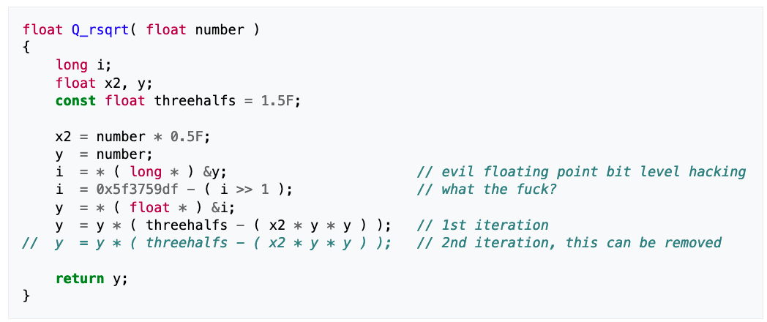
!@#$
https://en.wikipedia.org/wiki/Fast_inverse_square_root#Overview_of_the_code

Slide 13
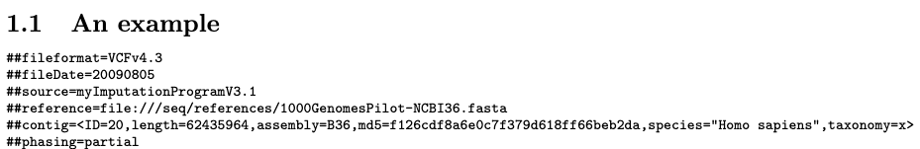
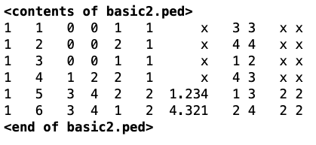
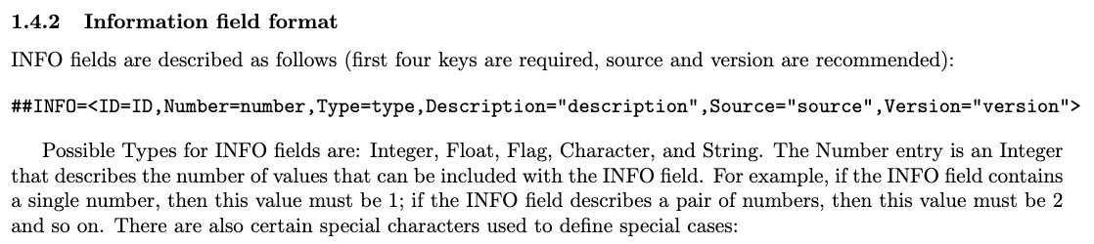
File formats: Open to interpretation
https://samtools.github.io/hts-specs/VCFv4.3.pdf
http://csg.sph.umich.edu/abecasis/merlin/tour/input_files.html

Slide 14
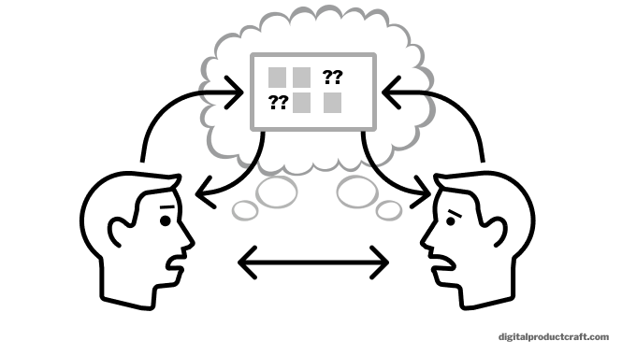
Externalizing ownership
All resources should be owned by the project, not one person
Mailing lists, Google Drive shared folders, domain names, etc
Key notes (including handoff documents) should not live in email, and test datasets should not live only in your user directory on a private project node
Inventory the services you depend on, and give someone access
Handoff documents are not written for the author. Have a friend try to use the instructions without your help*
* Then take your friend to lunch and apologize

Slide 15
Maintenance mode
Minor bugfixes and keeping the lights on

Slide 16

Know how to find things
Check your service inventory
Know how to find critical code, data, and infrastructure
Be able to interpret intent (“what is column 11 in this file? It seems important”)
Reference key points of contact
If key resources are restricted, who can give you access?
Are there special requirements (like IRB)?
Write stuff down while you still remember it!

Slide 17

Things will break when left alone
Command line tools
Dependencies may change; pin versions you depend on
Data standards may change, or FTP sites may vanish- capture sample input
Web servers
Security updates must be installed, which could change how things work
Third party services may change or be turned off
Have a clear plan to validate new releases/ security updates
Automate as much as possible
“Data Sharing and Management Snafu in 3 short acts” - https://www.youtube.com/watch?v=66oNv_DJuPc
Notes:
Give your successor the ability to issue updates. Do not assume that a finished project will never need to be touched (“...it’s perfect, so I don’t need to document it! You’re welcome!”)

Slide 18




Know when to pay attention
Set clear priorities based on usage (“paper actively under review” vs “people only visit for nostalgia”)
Automated alerts tell you when something needs to be done
Some CSG machines have Nagios email alerts (examples: memory, disk usage, expired SSL certs, network issues, whether key processes are running)
Do not rely on users to report downtime. They rarely report bugs.
Mailing lists and public bug trackers let users reach “the project” regardless of who is currently responsible
Notes:
The key to successful maintenance mode is to be able to ignore the project as long as possible without disaster. Automated alerts tell you when attention is required, which can reduce the recurring workload.
As you identify frequent manual steps, use the opportunity to streamline things a little at a time.

Slide 19
Worst case scenario / Disaster Recovery
If the server breaks, is the project dead?
For a web site, make this decision early on, and communicate when it changes
Can a new environment be created automatically?
Can you find and generate critical data files from scratch?
Backups should be validated, frozen, and stored off site before you go into maintenance mode

Slide 20
“Hibernation” vs “Planned end date”
Not every project is a good candidate to be maintained indefinitely
Sensitive data must be protected
Unpatched machines could be exploited, and you would never know
Routine operations may have unforgiving deadlines
Missed domain renewal → anyone could impersonate a major research study
Missed IRB renewal → (...you don’t want to know)
Do not leave robots unattended
“Bring your own data” cloud services are a blank check against your bank account
Expect people to abuse your service eventually
https://www.wired.com/story/parler-hack-data-public-posts-images-video/
https://www.csoonline.com/article/3444488/equifax-data-breach-faq-what-happened-who-was-affected-what-was-the-impact.html
Notes:
If there are legal, ethical, or catastrophic financial implications, it may be better to end the service on your terms rather than ignoring it until disaster strikes.

Slide 21
Living projects
Sustaining momentum after you’re gone
Gardner, P. P. et al. Sustained software development, not number of citations or journal choice, is indicative of accurate bioinformatic software. http://biorxiv.org/lookup/doi/10.1101/092205 (2016) doi:10.1101/092205.

Slide 22

Recognize that needs may change
In a living project, no decision is final. Both maintenance and domain requirements are equally important
Do everything from the previous lists
Disaster recovery plans are no longer optional
Plan to revisit methods and implementation based on scale change
Without good requirements capture and process automation, the team will be crushed by maintenance of old stuff
Make sure that people with different expertise can work together
Cechova, M. Ten simple rules for biologists initiating a collaboration with computer scientists. PLoS Comput Biol 16, e1008281 (2020). https://journals.plos.org/ploscompbiol/article?id=10.1371/journal.pcbi.1008281

Slide 23
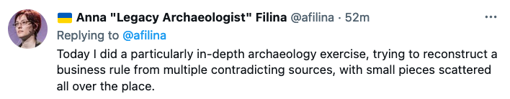

Slide 24
Barriers to collaboration
Brittle systems
Stuff that never actually worked (“did I create this bug?”)
Inaccurate documentation (“none of the sample commands work”)
No shared picture of reality
Lack of version control
Servers that are routinely edited by hand (test environments != production)
Secret or overly specialized knowledge
Bug reports and renewal notices go to former employee
Configuration-driven workflow systems whose behavior is only defined at deployment time, and cannot be inferred from code
No standard languages, tools, or habits
https://medium.com/capital-one-tech/lessons-from-the-leadership-trenches-how-do-i-choose-the-right-programming-language-for-my-team-36222aa78b38

Slide 25
Example: Languages I’ve worked with at CSG
Python (2 and 3)
Flask, Django/ DRF, FastAPI, pandas, jupyter, numpy, matplotlib
PHP (v5 and v7) (Frameworkless and partial adoption of Laravel)
JavaScript (ES5, ES2015+, node.js)
D3 (v3 and v5), JQuery, Vue.js, Backbone.js
Presentation layer: HTML, SVG, bootstrap 3-4, material UI, tailwind CSS
R
Go
Java
C++
Build/ dependency /automation/ deployment systems
Make, snakemake, cmake, bash scripts, Docker, some ansible
Webpack, babel, gulp, parcel, rollup, browserify, vue cli
pip, pipenv, poetry, conda, yarn, npm, go, cargo, cget, composer
Infrastructure environments
Google Cloud, AWS, on prem
Databases / Queryable storage
MySQL, PostGres, Sqlite, Mongo, Tabix, Parquet
Lack of a common team baseline is a hidden tax on productivity
Choose technologies that can be supported by your team after you leave
Learning is great, but no one wants to maintain your custom malbolge interpreter
Notes:
Having shared standards can help teams to be more productive, and remove the hidden tax on productivity that comes from frequent context switches

Slide 26
Sample archival checklist: CLI Tools
Code is available in a stable “source of record” (eg public version control)
Ensure that at least one other person can release “official” bugfixes
Tidy up: ADD comments / citations, and REMOVE unused code and files
Instructions can be followed without additional help
Code compiles and runs on a “clean” environment (eg docker or CI server)
Identify how to validate the software
Automate with small example test set if possible
Given same code and input files, can someone reproduce the figures in your paper?
Tag the version of code used to generate a paper
Externalize ownership
Have someone read and try the instructions
Provide an inventory of key resources and make sure someone else has access
Transfer ownership of mailing lists, shared documents, monitoring services, etc
GitHub organization: https://github.com/statgen/

Slide 27
Web Apps: sample inventory of key resources
Where to download key resource files
If access is required, identify point of contact (people are resources too!)
Provide a citation in case the FTP site is reorganized
Things not stored in version control
Configuration files, application secrets
External dependencies (Box/ Google Drive folders, Facebook/ Google Login, etc)
How to find AND obtain access to key services- give PI access as fallback
List of servers and databases + access credentials
Third party services (analytics, mailing lists, issue tracker, domain registrations)
Monitoring systems (Nagios, Sentry) and billing reminders
Grant PERMISSIONS, not just ACCESS. A locked console is not useful.
Process
Data dictionary for config/resource files: “the entire script depends on column 11, what’s that?”
Secret knowledge: “Things I check manually but never found time to automate”
Tips to the next person: “Stuff I think is worth doing in the future”
Critical files that you must be able to find fast (eg IRB documents)
Operations and disaster recovery
Standard operating procedures / automated scripts / service-specific repositories (Terraform, ansible, etc)
Call out key items that are time sensitive and can’t be ignored (billing alerts, IRB paperwork, domain renewals, etc)
Backups

Slide 28
Further reading
(*) Ten simple rules for making research software more robust - https://journals.plos.org/ploscompbiol/article?id=10.1371/journal.pcbi.1005412
Good enough practices in scientific computing https://journals.plos.org/ploscompbiol/article?id=10.1371/journal.pcbi.1005510
(*) Ten simple rules for biologists initiating a collaboration with computer scientists https://journals.plos.org/ploscompbiol/article?id=10.1371/journal.pcbi.1008281
JOSS review checklist: https://joss.readthedocs.io/en/latest/review_checklist.html
Best practices for writing code comments: https://stackoverflow.blog/2021/12/23/best-practices-for-writing-code-comments/
Data dictionary: https://library.ucmerced.edu/data-dictionaries
Runbooks and Playbooks: https://www.pagerduty.com/resources/learn/what-is-a-runbook/

Slide 29
Places to archive things
Version Control: https://github.com/statgen/
Also provides public issue tracker for reporting bugs!
Citable DOIs for research articles: https://help.zenodo.org/features/
Or other domain specific hosting services (GWAS catalog, Figshare, Dataverse, OSF, etc)
KeePassXC encrypted password manager: https://keepassxc.org/
“Requester pays” option for big datasets (cloud storage)
Group wiki
https://genome.sph.umich.edu/wiki/Main_Page
https://statgen.sph.umich.edu/wiki/
UMich services:
https://its.umich.edu/accounts-access/leaving
Shared accounts: https://documentation.its.umich.edu/node/501
MCommunity Groups: https://documentation.its.umich.edu/node/370

Slide 30
Summary
Archives should be self-contained
Don’t wait until the end for cleanup! Use good practices throughout the development process
Keep a record of key services and how to access them
Shared standards help people with different skills work together
Expect people to graduate, and plan ahead

